Slide 1
OLIST STORE ANALYSIS
Analysing Key Performance Indicators

Slide 2
Overview of the project
- Data sources - Key Performance Indicators (KPIs) - Tools used (Excel, MySQL, Tableau, PowerBI) - Analysis Steps - Dashboards - Conclusion

Slide 3
SUMMARY
Olist is an intermediary a Brazilian e-commerce platform that streamlines the e-commerce process for sellers and provides a convenient marketplace for buyers. It offers services ranging from product listing to order fulfillment and leverages data to enhance the overall selling experience on its platform.

Slide 4
DATA SET DETAILS
DATA SET CONTAINS INFORMATION ABOUT OLIST STORE .
DATA SET HAS TOTAL 9 SHEETS AS FOLLOWS
olist_order_items_dataset
olist_order_payments_dataset
olist_order_reviews_dataset
olist_orders_dataset
olist_products_dataset
olist_sellers_dataset
product_category_name_translation
olist_customers_dataset
olist_geolocation_dataset

Slide 5
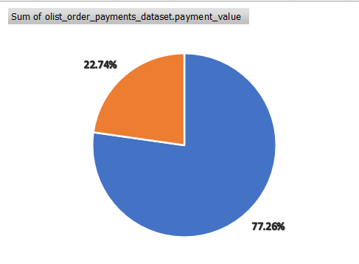
KPI 1 : Weekday Vs Weekend (order_purchase_timestamp)
Question: What are the differences in order volume between weekdays and weekends, and which promotions have proven to be most effective in balancing staff workload and maximizing sales on weekdays?
Insight: Weekdays have more orders than weekends, so businesses should staff up and offer special promotions during the week

Slide 6
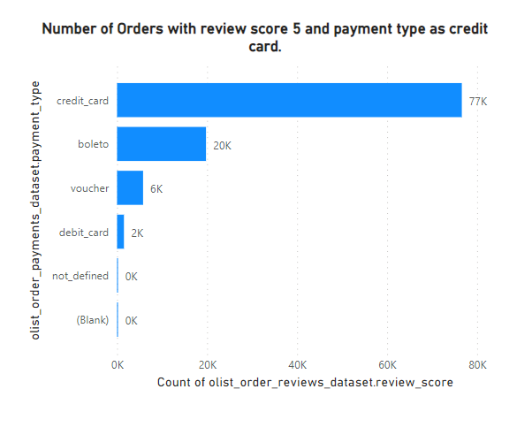
KPI 2 : Number of Orders with review score 5 and payment type as credit card
Question: How do the number of 5-star reviews compare when payment is made with a credit card versus other payment methods, and which credit card promotions have the strongest positive impact on customer satisfaction?
Insight: Most orders with 5-star reviews were paid for with credit card, so businesses should offer special promotions for credit card payments

Slide 7
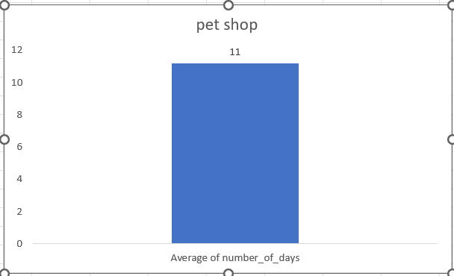
KPI 3 : Average number of days taken for order_delivered_customer_date for pet_shop.
Question: What is the current average delivery time for pet shop orders, and how does this compare to the delivery time improvements seen when partnering with faster shipping carriers?
Insight: Pet shop orders take longer days to deliver, so businesses should set realistic delivery expectations and partner with faster shipping carriers

Slide 8
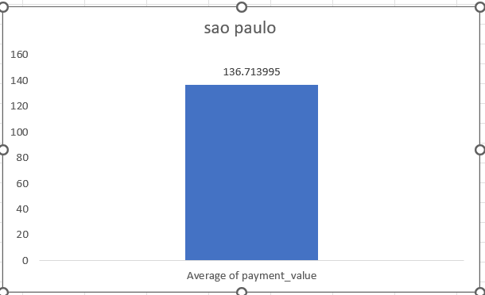
KPI 4 : Average price and payment values from customers of Sao Paulo city
Question: What are the spending patterns of customers from São Paulo in terms of average order value, and which product categories and discount strategies have led to increased sales in this region?
Insight: São Paulo customers spend money on online orders, so businesses should offer a wider selection of products and services with attractive discounts

Slide 9
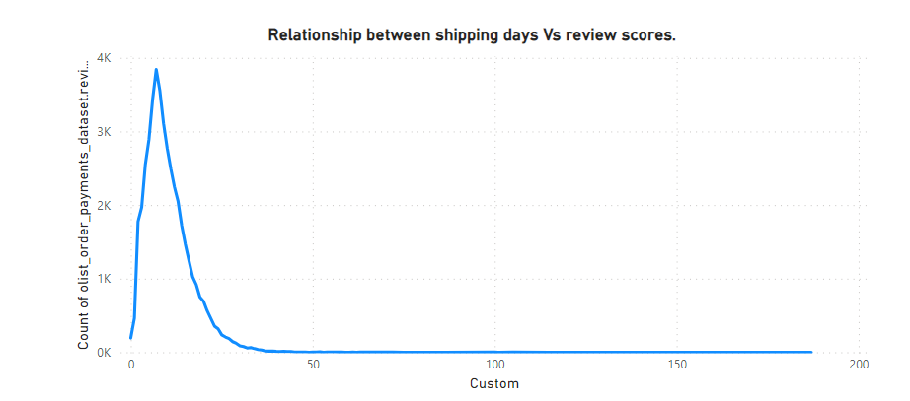
KPI 5 : Relationship between shipping days (order_delivered_customer_date - order_purchase_timestamp) Vs review scores
Question: How does the length of shipping time correlate with customer review scores, and what improvements in the shipping process can most effectively decrease shipping days and enhance overall customer satisfaction?
Insight: Customers give higher review scores for faster shipping, so businesses should focus on improving their shipping times

Slide 10
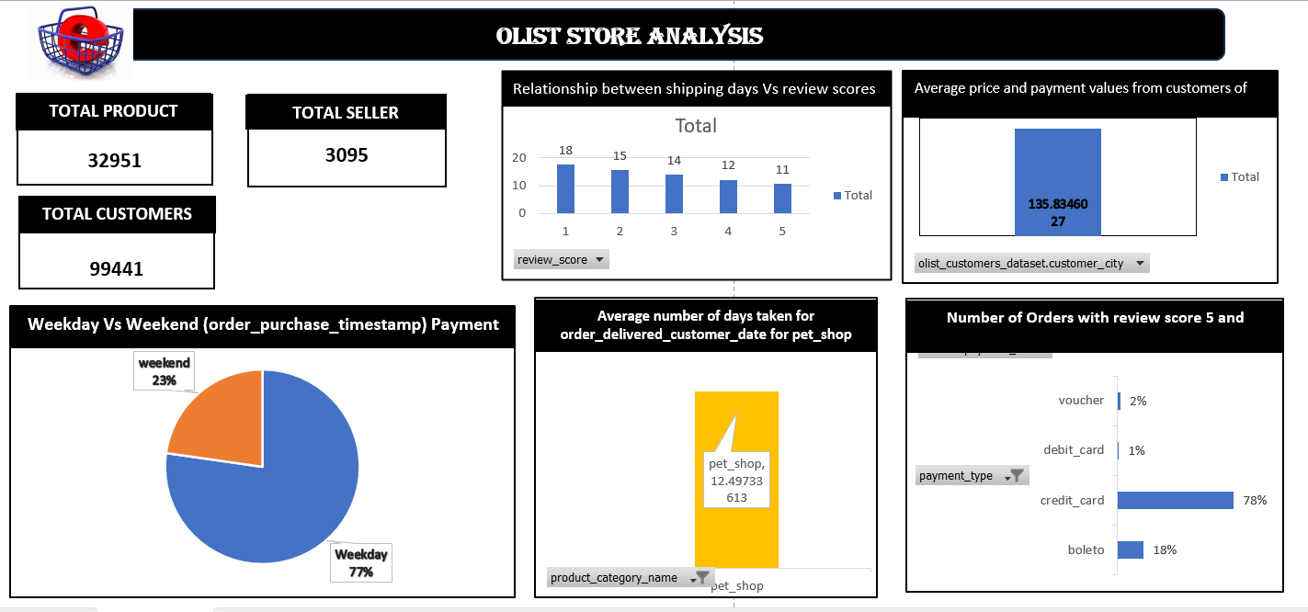

Slide 11
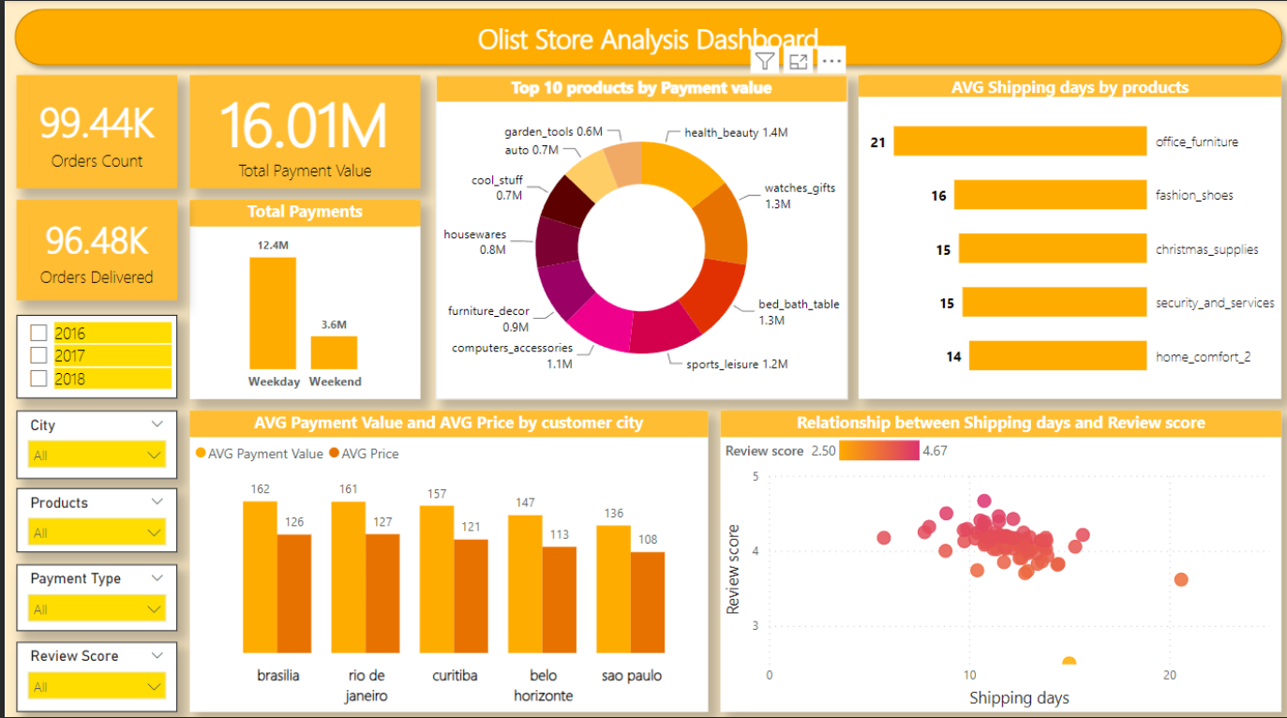

Slide 12
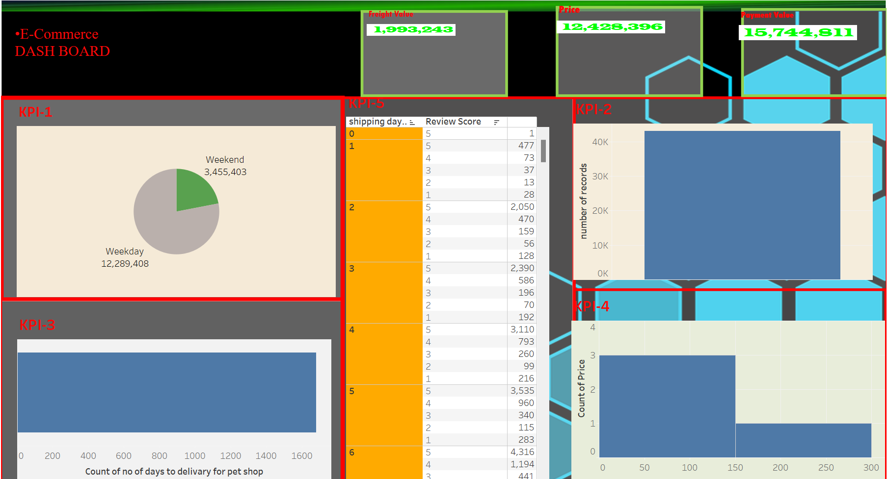
TABLEAU

Slide 13
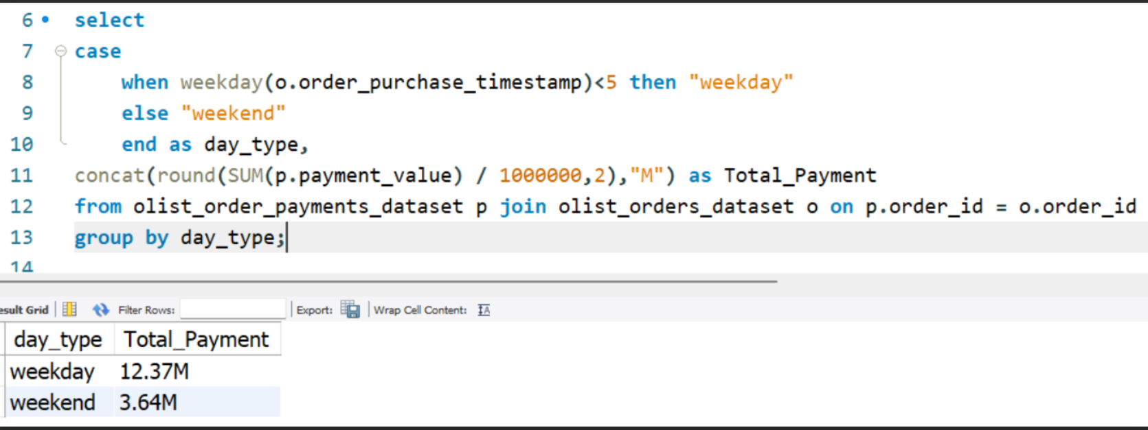
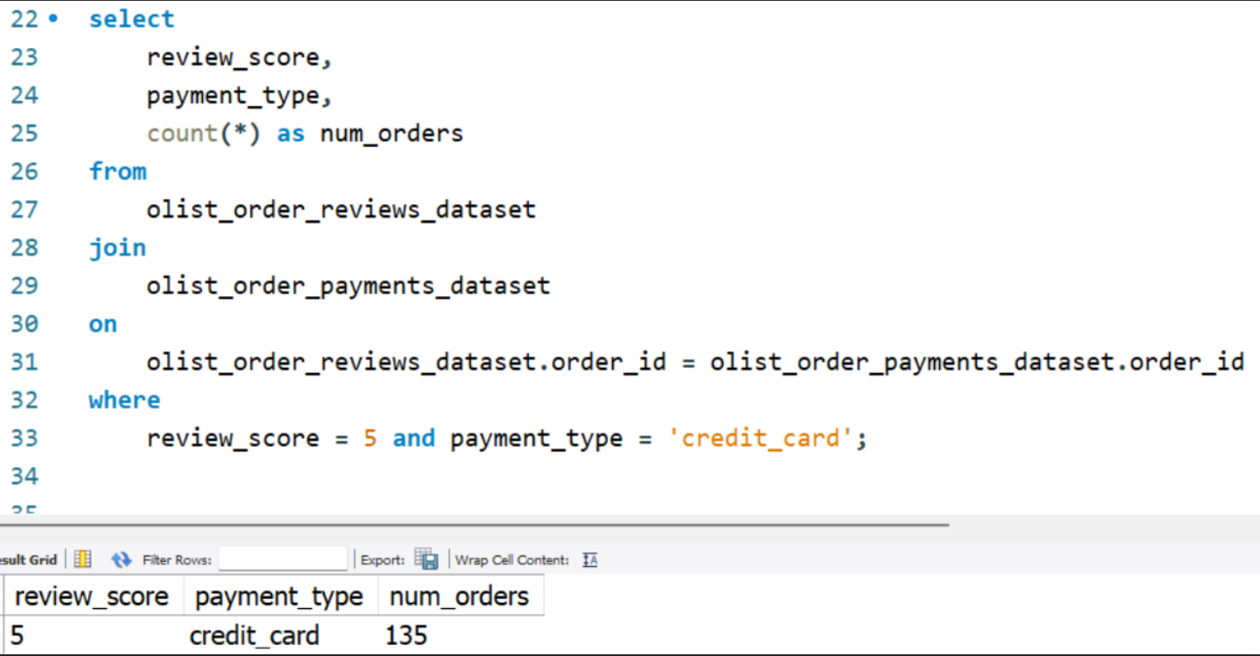
SQL
KPI 1- Weekday Vs Weekend Payment Statistics
INSIGHTS: Weekdays have more orders than weekends, so businesses should staff up and offer special promotions during the week
KPI 2- Number of Orders with review score 5 and payment type as credit card.
INSIGHTS: Most orders with 5-star reviews were paid for with credit card, so businesses should offer special promotions for credit card payments

Slide 14
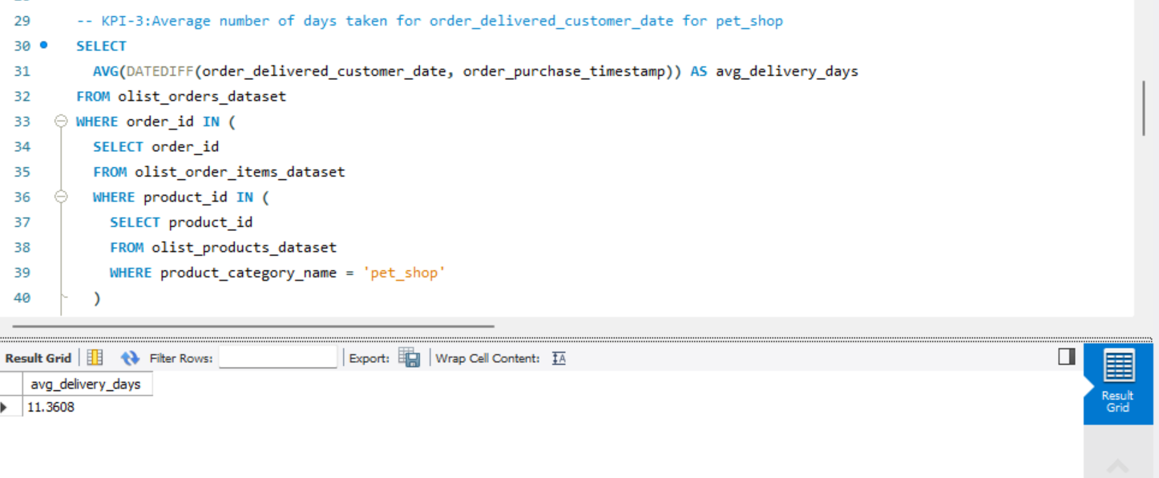
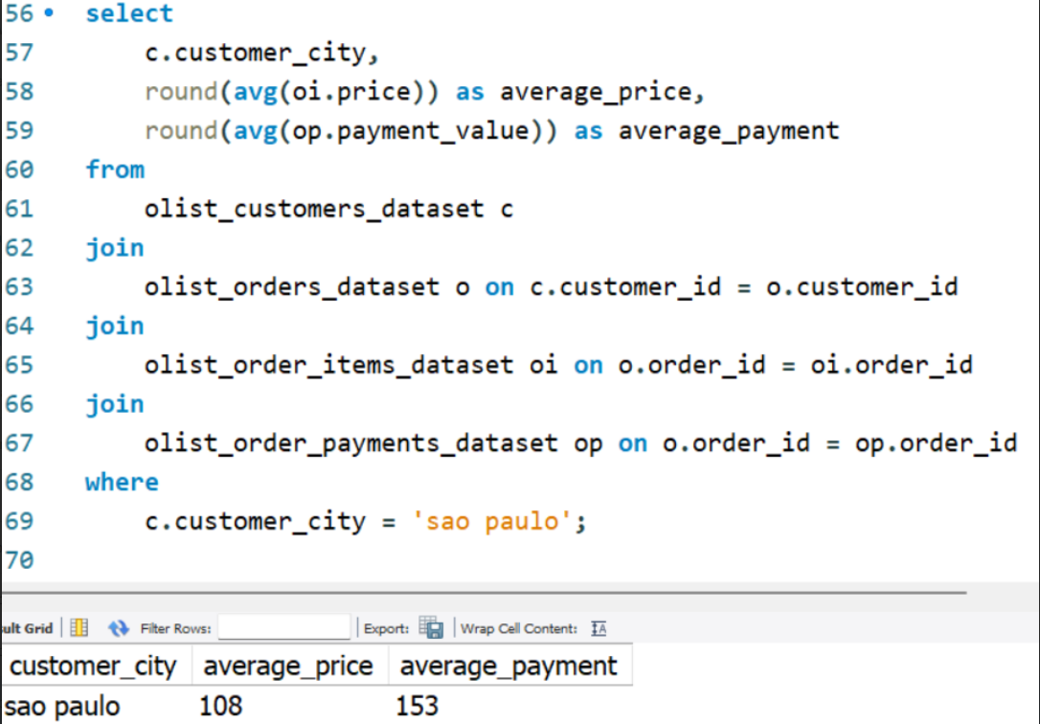
KPI 3 - Average number of days taken for order_delivered_customer_date for pet_shop
INSIGHTS: Pet shop orders take longer days to deliver, so businesses should set realistic delivery expectations and partner with faster shipping carriers
KPI 4 - Average price and payment values from customers of sao paulo city
INSIGHTS: São Paulo customers spend money on online orders, so businesses should offer a wider selection of products and services with attractive discounts

Slide 15
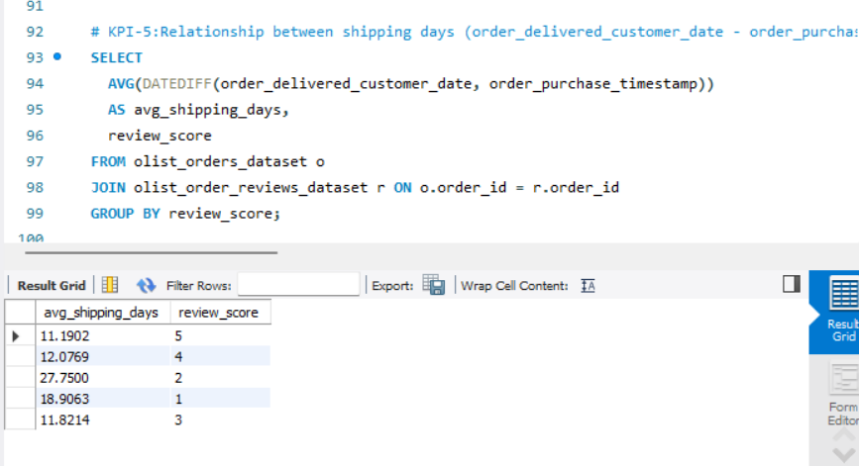
KPI 5 - Relationship between shipping days (order_delivered_customer_date - order_purchase_timestamp) Vs review scores.
INSIGHT :Customers give higher review scores for faster shipping, so businesses should focus on improving their shipping times

Slide 16
CONCLUSION
Total order = 99442
Total revenue = 16.01M
Total number of seller =3095
Total number of product = 71
TOP 5 purchased product
health_beauty
bed_bath_table
sports_leisure
computers_accessories
watches_gifts

